Slide 1
Understanding of Image Relationship Detection
Author:
Zehan Song

Slide 2
Outline
Detecting Visual Relationships with Deep Relational Networks
Phrase Localization and Visual Relationship Detection with Comprehensive Image-Language Cues
Deep Variation-structured Reinforcement Learning for Visual Relationship and Attribute Detection

Slide 3
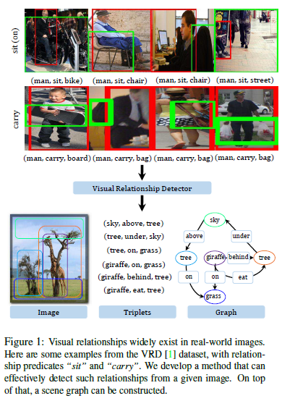
Detecting Visual Relationships with Deep Relational Networks
Motivation:
Being able to recognize individual objects is generally not sufficient. The relationships among them also contain crucial messages.
Goal:
The task is to locate all visual relationships from a given image, and infer the triplets.

Slide 4
Detecting Visual Relationships with Deep Relational Networks
Early attempts:
consider visual phrases as different classes. (too much and imbalanced)
Alternative strategy:
consider each type of relationship predicates as a class. (drastically smaller and increase diversity within each class)
This work:
Formulate the prediction output as a triplet in the form of (subject, predicate, object) and jointly infer their class labels by exploiting two kinds of relations among them, namely spatial configuration and statistical dependency. (ubiquitous, informative and such relations are more reliable than visual appearance)

Slide 5
Detecting Visual Relationships with Deep Relational Networks
Earlier efforts often focus on specific types of relationships, such as positional relations and actions (i.e. interactions between objects).
This work aims to provide a method dedicated to generic visual relationship detection and can recognize
a wide variety of relationships, such as relative positions (“behind”), actions (“eat”), functionals (“part of”), and comparisons (“taller than”).

Slide 6
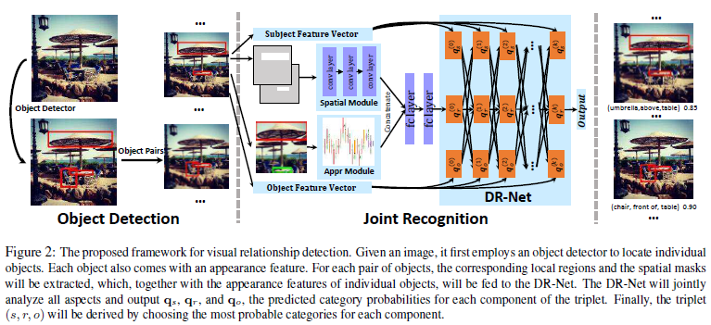
Detecting Visual Relationships with Deep Relational Networks
Object detection:
Input: an Image
Output: candidate objects
Method: Faster RCNN
Pair filtering:
Input: n(n-1) object pairs
Output: meaningful object pairs
Principle:
spatial configurations (too far)
Object categories (meaningless)
Joint recognition:
Input: retained object pairs
Output: a triplet for each object pair
Basis: multiple factors and relations

Slide 7
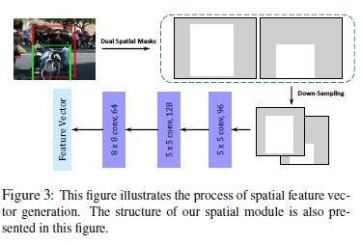
Detecting Visual Relationships with Deep Relational Networks
Multiple factors taken into consideration in Joint Recognition
Appearance
Extract an appearance feature by applying a CNN to an enclosing box for each object pair.
Spatial Configurations
Relative positions and relative sizes between two objects complementary to the appearance of individual objects.
Dual spatial masks (one for the subject and the other for the object) derived from the bounding boxes.

Slide 8
Detecting Visual Relationships with Deep Relational Networks
Multiple factors taken into consideration in Joint Recognition
3. Statistical Relations
There exist strong statistical dependencies between the relationship predicate r and the object categories s and o.
Integrated Prediction
For each candidate pair, the framework extracts the appearance feature and the spatial feature to form a compressed pair feature. This compressed feature together with the appearance feature of individual objects are fed to the DR-Net for joint reference.
These stages are trained respectively. As for joint recognition different factors will be integrated into a single network and jointly fine-tuned to maximize the joint probability of the ground-truth triplets.

Slide 9


Detecting Visual Relationships with Deep Relational Networks
CRF formulation for the task of recognizing visual relationships.
Limited!!!
Hard to compute Z
Poor estimates

Slide 10





Detecting Visual Relationships with Deep Relational Networks
Symmetry constraints
Weights sharing
Special form of RNN

Slide 11
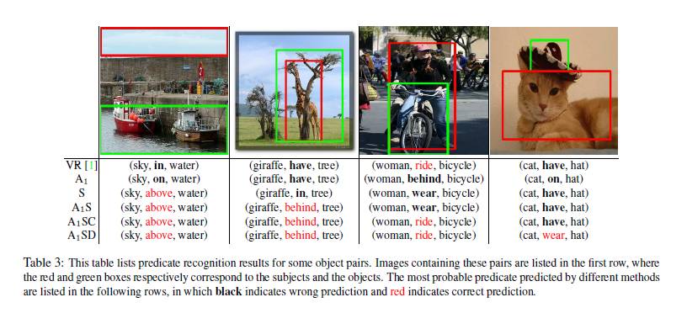
Detecting Visual Relationships with Deep Relational Networks
1,2 column
S: positional relationships
3 column
C/D: ambiguities
4 column
DR-Net is better than CRF

Slide 12
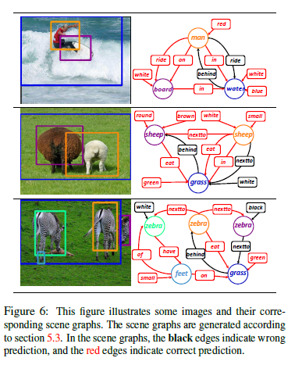
Detecting Visual Relationships with Deep Relational Networks
Better relationship detection,
Better scene graphs.

Slide 13
Detecting Visual Relationships with Deep Relational Networks
Conclusion:
Integrate a variety of cues: appearance, spatial configurations, statistical relations between objects and relationship predicates.
The heart of the framework is the Deep Relational Network (DR-Net), show the expressive power of deep neural networks to relational modeling.

Slide 14
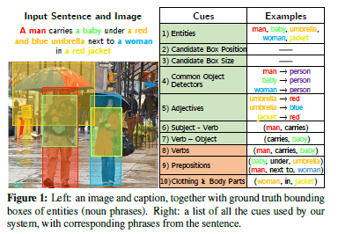
Phrase Localization and Visual Relationship Detection with Comprehensive Image-Language Cues
Goal:
accurately localize a bounding box for each entity (noun phrase) mentioned in a caption for a particular test image

Slide 15
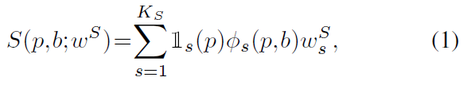
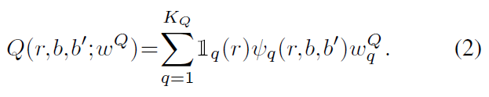
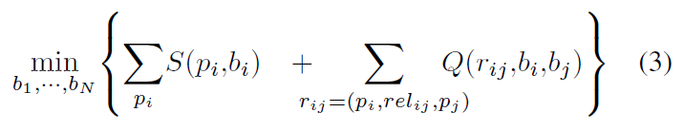
Phrase Localization and Visual Relationship Detection with Comprehensive Image-Language Cues
Joint phrase localization:
Single phrase
14 single-phrase cost functions:
region phrase compatibility
score
phrase position
phrase size (8)
object detector score
adjective
subject-verb
verb-object scores
A pair of phrases
3 pairwise cost functions:
spatial classifiers for
verb
preposition
clothing and body parts relationships

Slide 16
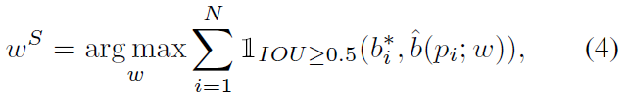


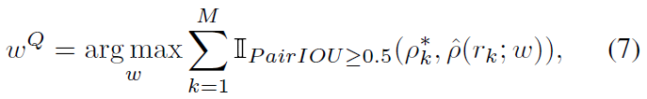
Phrase Localization and Visual Relationship Detection with Comprehensive Image-Language Cues
Learning scoring function weights:
Single phrase
unary weights
N is the number of phrases in the training set
returns the most likely box candidate for phrase p under the current weights
A pair of phrases
M is the number of phrase pairs with a relationship
returns the number of correctly localized boxes (0, 1, or 2)
return the best pair of boxes for the relationship r = (p, rel, p’)

Slide 17
Phrase Localization and Visual Relationship Detection with Comprehensive Image-Language Cues
Conclusion:
Most of previous works only use noun phrases
But this work use verbs, preposition and pronouns etc. as additional information
Comprehensive Image-Language Cues demonstrated significant gains over the state of the art on two tasks: phrase localization on Flickr30k Entities and relationship detection on the VRD dataset

Slide 18
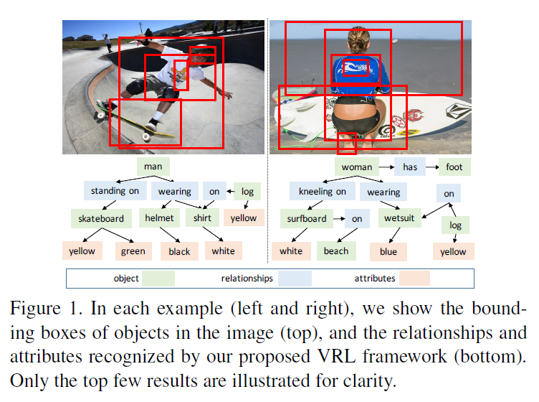
Deep Variation-structured Reinforcement Learning for Visual Relationship and Attribute Detection
This work proposes a deep Variation-structured Reinforcement Learning (VRL) framework to sequentially discover object relationships and attributes in the whole image.

Slide 19
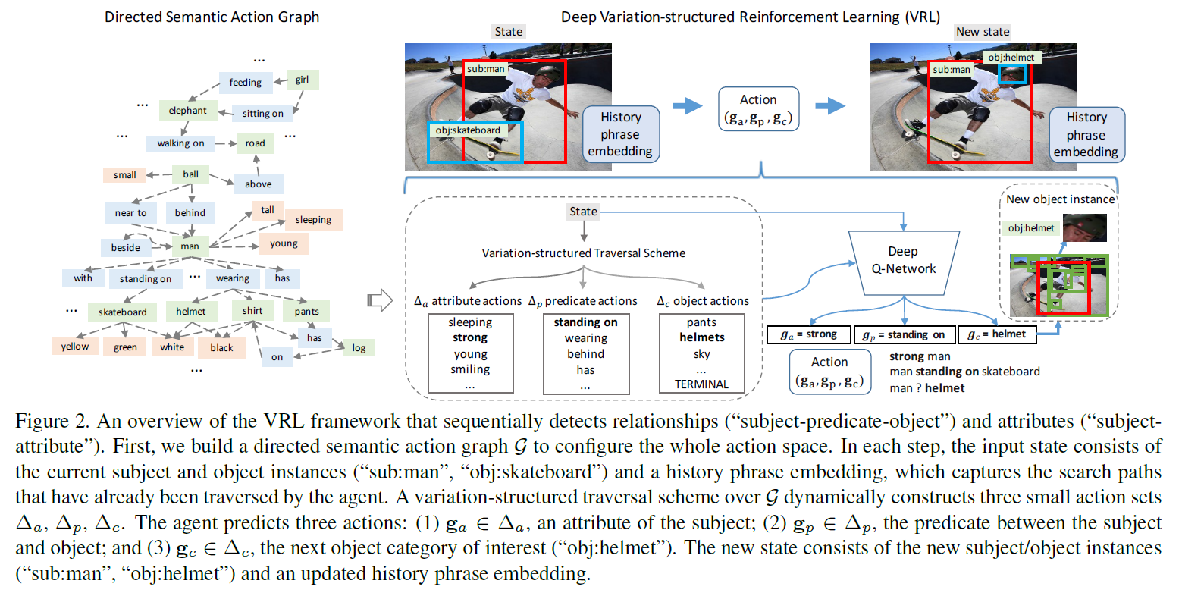
Deep Variation-structured Reinforcement Learning for Visual Relationship and Attribute Detection

Slide 20
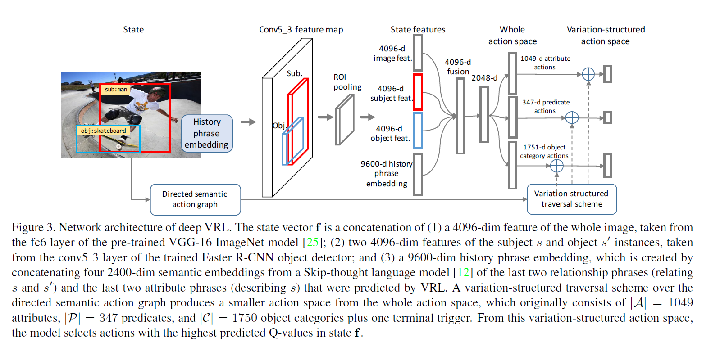
Deep Variation-structured Reinforcement Learning for Visual Relationship and Attribute Detection

